Slide 1
Lecture 3
Text and Binary File Processing:
A review

Slide 2
Main Points
Text Files
  Different functions/operations
    File pointer variable
    Using a a file, closing a file…
Binary files
  Comparison between text and binary files
  Manipulating a binary file
C Exercises

Slide 3
Text & Binary File Processing
An external collection of data treated as a unit.
Text File: Continuous stream of characters broken into lines by the new-line character!
  ‘A’, ‘a’, ….., ‘\\’,’%%’, EOF, ‘\n’, ‘\t’, ‘\b’..
Binary File: Collection of Bits (0’s & 1’s)

Slide 4
File Properties
File properties:
  Name
  Must be opened (Otherwise, you can not work with it)
  Must be closed. (Once you are done with it, close it)
  Can be written to.
  Can read from.
  Can be appended to.
How can these operations be carried out?

Slide 5
Text Files

Slide 6
Accessing Files
Procedure for Accessing a file:
  1. Declare a File Pointer
    FILE *my_file_Pointer
  2. Open the file & specify the Access mode (Read, Write, Append)
    my_file_pointer = fopen(“c:My_data.txt”, “w \r \a \r+”)
    W: Write; r: Read; a: Append; r+: Read & Write
  3. Write/Read using fprintf/fscanf
  4. Close the file
    fclose(my_file_pointer)

Slide 7
More about access Modes
File Access Mode | Access Mode Use | fopen() return value
 |  | If file exists | If file does not exist
r | Reading | - | NULL
w | Writing | Over Write on Existing | Create a new file
a | Append | - | Create a new file
r+ | Reading +Writing | New data is written at the beginning overwriting existing data | Create a new file
w+ | Reading + Writing | Over write on existing | Create a new file
a+ | Reading + Appending | New data is appended at the end of the file | Create a new file

Slide 8
File Pointers / fopen
Before accessing any file you must declare File_Pointers and give descriptive names to them.
  File *infp; (file_pointer for reading)
  File *outfp; (file_pointer for writing)
fopen: returns a file pointer!
outfp= fopen(“filename”, “mode”)
  outfp = fopen(“c:data.txt”, “w”)
    If the file does not exist, it will be created. Same applies for appending.
    If the file exists, it will be overwritten
  infp = fopen(“c:data.txt”, “r”)
    If the file does not exist, fopen will return a NULL pointer. Same applies for r+.
    Useful  if (infp == NULL) printf(“File not found”);

Slide 9
Writing into a text file: fprintf
fprintf: The same syntax as printf, except that it takes one additional argument which is the file_pointer:
  FILE *outfp, *infp;
  char name[20];
  strcpy(name,”Smith”);
  outfp = fopen(“c:new_file”, “w”);
  fprintf(outfp, “Hello Mr. %s”, name);
  fclose(outfp);

Slide 10
Reading from a text file: fscanf
“File_pointer” is the additional argument to scanf.
  File *infp;
  char name[20];
  infp = fopen(“c:data.txt”, “r”);
  if (infp == NULL) printf(“FILE NOT FOUND”);
  else {
  fscanf(infp, “%s”, name);
  printf(“The name in the file is: %s”, name);
  fclose(infp);
  }

Slide 11
Other functions for file Read/Write
getc: int getc(FILE *stream)
  gets a character from a file pointer
  returns the character read as an unsigned char cast to an int or EOF on end of file or error
  ch = getc(infp);
fgets: char *fgets(char *str, int n, FILE *stream)
  gets a string from a file pointer
  fgets(char *name, int n, FILE *infp);
  function returns the same str parameter. If the End-of-File is encountered and no characters have been read, the contents of str remain unchanged and a null pointer is returned.

Slide 12
More about file functions
putc: int putc(int char, FILE *stream)
  writes a character (an unsigned char) specified by the argument char to the specified stream
  returns the character written as an unsigned char cast to an int or EOF on error.
fputs: int fputs(const char *str, FILE *stream)
  writes a string to the specified stream but not including the null character.

Slide 13
Exercise 1: reading file content and printing it to the screen.
Assume that we have a file that contains students records: student name and a final grade. We need to write a C program that read students records and print them in a table format.

Slide 14
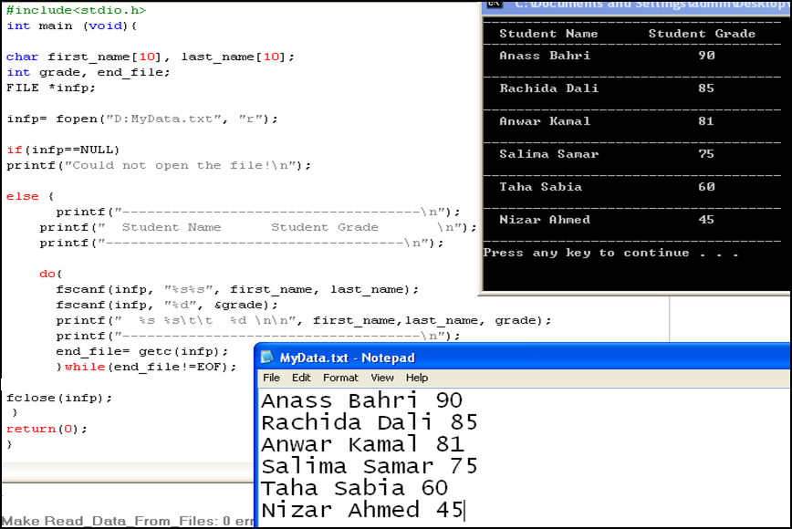
Solution

Slide 15
Take Home Exercise
Change the previous code so that the user will add an additional student record (Leila Salim 80) to the file.
  To better understand the use of different file access modes, use the following access options:
    r,w,a, a+,r+,w+
    Make a copy of the initial file before you make any change

Slide 16
Sometimes, it is better to read the file content as a collection of data types
Assume that we have an input file that contains students grades. Out of the list of these students, we want to generate an output file that contains students names who got a failing grade.

Slide 17
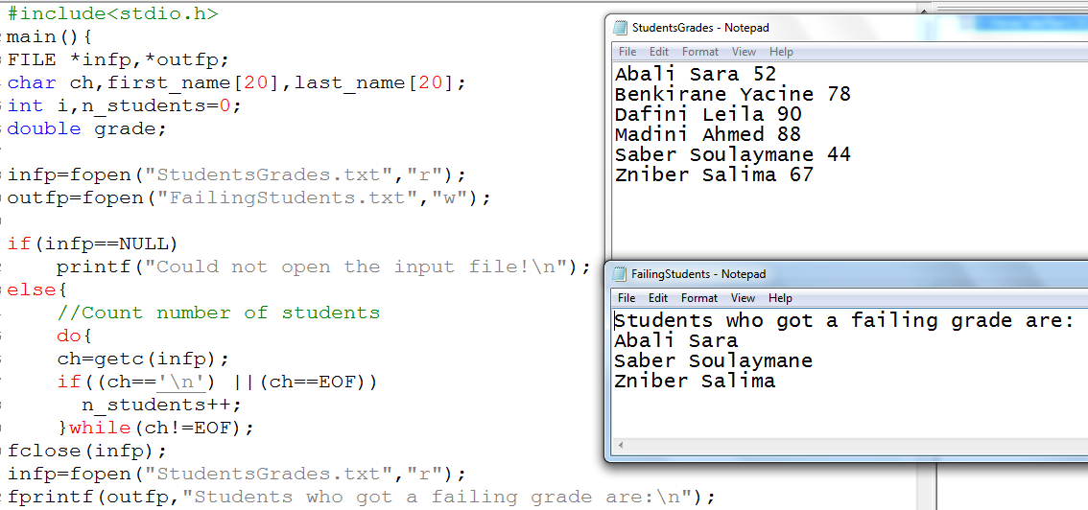

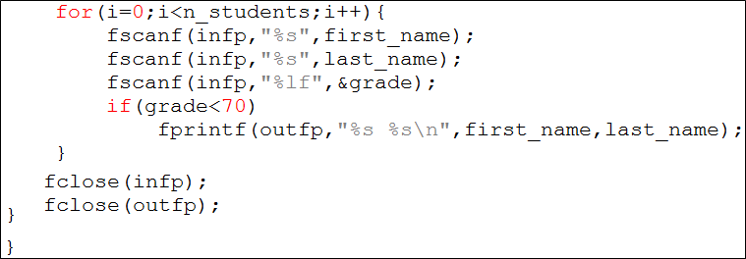

Slide 18
Exercise: in some cases, we need to work with characters
We need to write a C program that counts how many words, lines, letters, digits and other characters in a text file.
  Hint:
    Isalnum(): returns non-zero if its argument is
    a numeric digit or a letter of the alphabet.
    Otherwise, zero is returned.

Slide 19
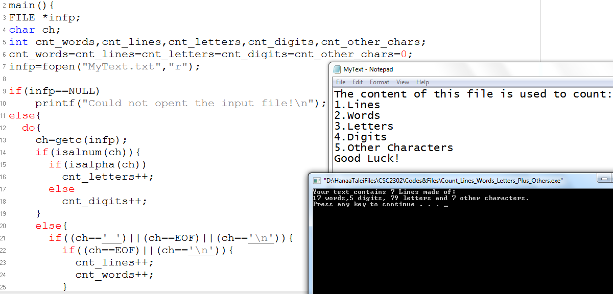
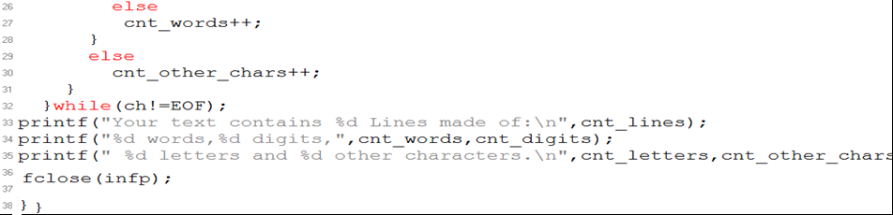

Slide 20
Exercise from your book
Write a C program where you use two files
The first file will contain some text
The second file will contain the list of words in the first file along with the length of every word
Make sure that you print the number of words in the output file.

Slide 21
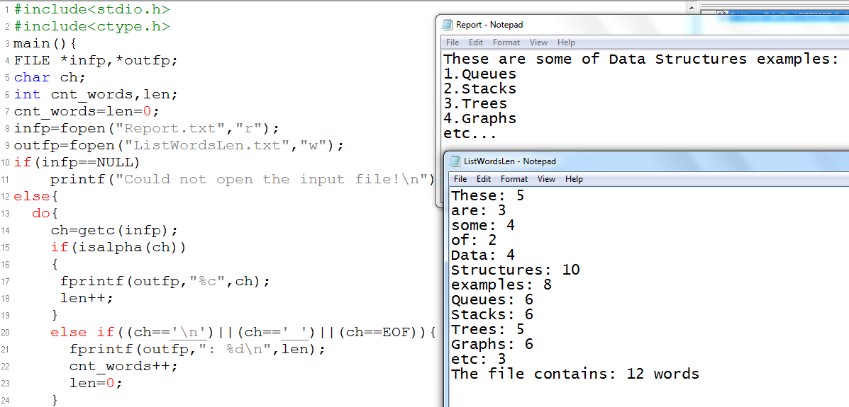
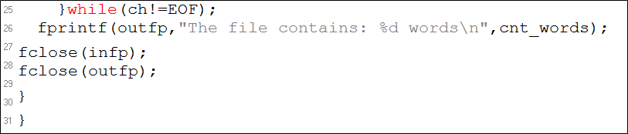

Slide 22
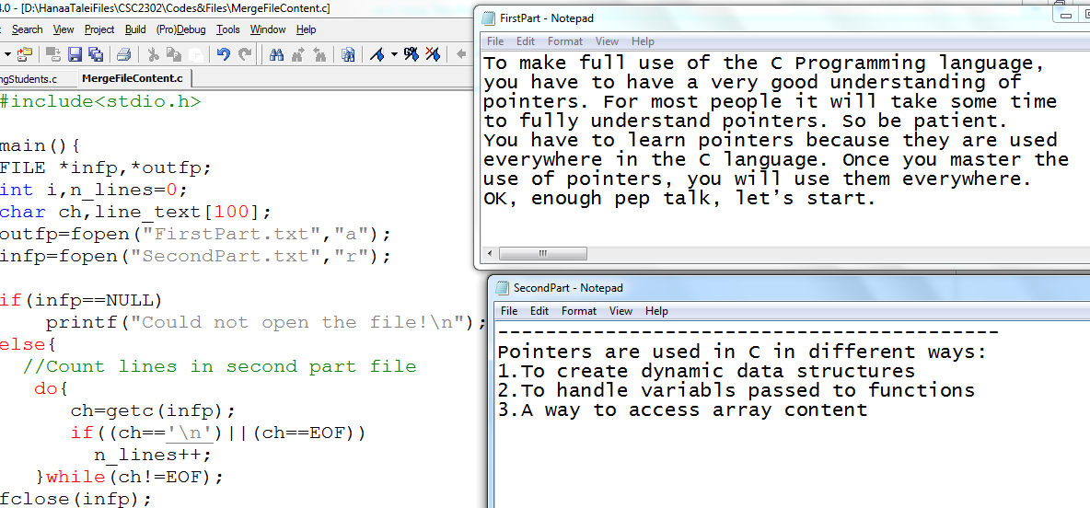
Another exercise from the book: merging the content of two files. Sometimes, better to read a line at a time

Slide 23
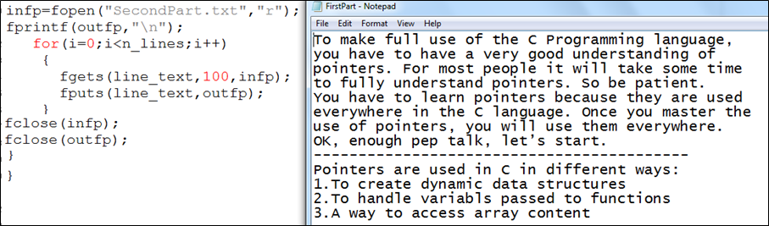
Cont…

Slide 24
Binary Files

Slide 25
Using Binary Files
Same procedure as for Text files applies
  1. Declare a file pointer:
    FILE *infp_b;
  2. Open the file & specify the Access mode:
    infp_b = fopen(“d:MyFile.bin”, “wb”)
     a prefix “b” is added to the mode to specify binary.
  3. Write/Read using fwrite/fread
  4. Close the file:
    fclose(infp_b);

Slide 26
fwrite() Function
fwrite takes four arguments:
  Exp: fwrite(array, sizeof(double), Max_Size, outfp_b)
  1st arg: specifies the address of the first element to be copied.
  2nd arg: specifies the size of one component in bytes.
    Sizeof( data_type_elt): is a C built-in function that returns the size of Data_Type_Elt in bytes. Exp:
    printf(“The size of a char is %d”, sizeof(char));
  3rd arg: specifies the number of values to be written. “Here Max_size is the size of the array”.
  4th arg: specifies the output file pointer.
Example:
  fwrite(&ch, sizeof(char), 1, outfp_b)
  This statement would copy one character held in the ch variable.

Slide 27
fread() Function
fread takes also four arguments:
  The arguments are the same as for fwrite
Example
  fread(&i, sizeof(int), 1, infp_b)
  This statement would copy the correspondent number of bits of one integer value from the binary file to the integer variable i.
Example:
  fread(array, sizeof(double), Max_Size, outfp)
  This statement would fill the array with Max_Size elements of type double from the binary file

Slide 28
Exercise
A Text file contains some AUI courses codes along with their number of credits.
We need to write a C program that:
  Copy the content of the text file to a binary file.
  Ask the user for a course code and then search for its number of credits in the binary file

Slide 29
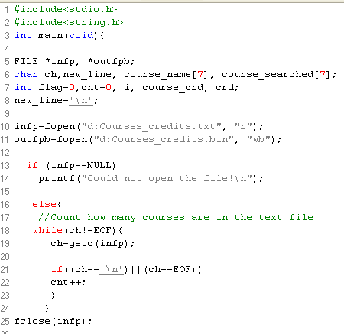
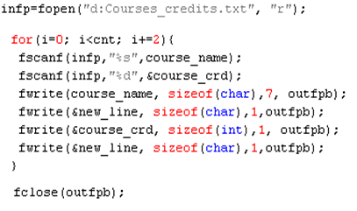
Solution

Slide 30
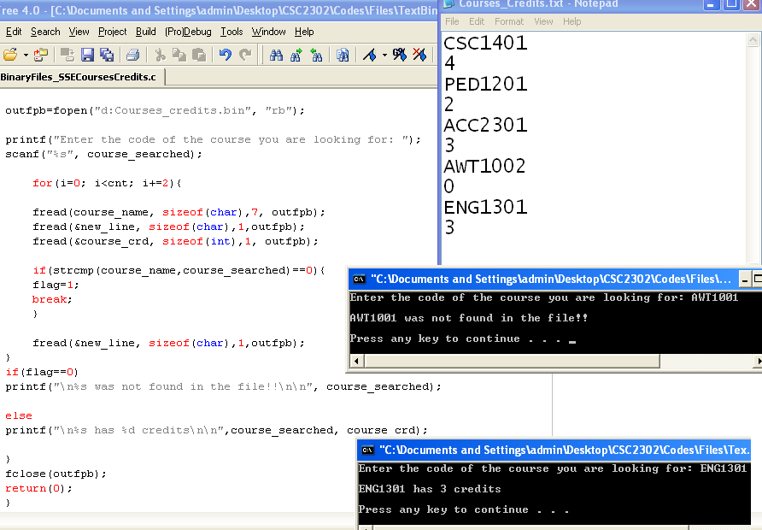
Solution (Cont..)

Slide 31
Cursor Positioning

Slide 32
Cursor Positioning: using fseek()
Syntax:
  fseek(FILE *infp, int offset, int wherefrom)
The fseek sets the position of the cursor to a specified position in a file.
It takes three arguments:
  Arg1: A pointer to a an open file
  Arg2: An integer that specifies the number of bytes the position indicator must move relatively to
  Arg3: An integer that can be equal to (0, 1, 2)
    0: Beginning
    1. Current
    2: End
fseek(infp, 2 , 1), move the cursor two bytes ahead from the current position
fseek(infp, -2, 2), move two bytes back from the EOF

Slide 33
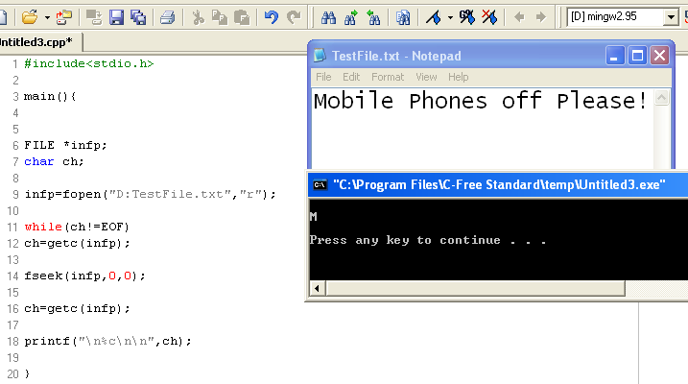
Illustration: in a text file

Slide 34
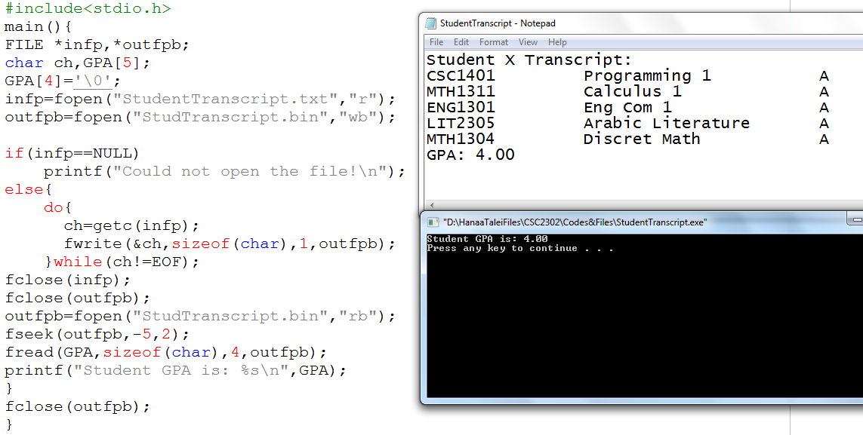
Illustration: in a binary file. An example where binary file is filled with data all of type char but we need to get a value double

Slide 35
In class Project Code using Files

Slide 36
Project New Requirements
Change the code so that you:
  Fill the array with students information that you get from a text file rather than a user input
  Add an additional menu option so that you generate two output files that contain the list of students who passed and who failed respectively.

Slide 37
